Slide 1

Supervised Machine Learning in Power BI
June 27, 2020
@Follow me
https://www.linkedin.com/in/profile-moez/
https://twitter.com/moezpycaretorg1
Moez Ali
https://medium.com/@moez_62905

Slide 2





About me
Data Analytics Leader by day and passionate Data Scientist by night
Active open-source contributor
Member of CPA, CMA, Canada and ACMA, UK CGMA
Lived and worked in Asia, Middle East, East Africa, North America
Currently based in Toronto, Canada
https://www.linkedin.com/in/profile-moez/
https://medium.com/@moez_62905/
https://twitter.com/moezpycaretorg1
moez@pycaret.org

Slide 3
Important Links
Official : https://www.pycaret.org
PyCaret GitHub : https://www.github.com/pycaret/pycaret
LinkedIn : https://www.linkedin.com/company/pycaret
YouTube : https://www.youtube.com/channel/UCxA1YTYJ9BEeo50lxyI_B3g
Medium : https://medium.com/@moez_62905/
Today’s Presentation and Demo : https://www.github.com/pycaret/pycaret-demo-eb2
Follow hashtag #pycaret on LinkedIn and Twitter

Slide 4
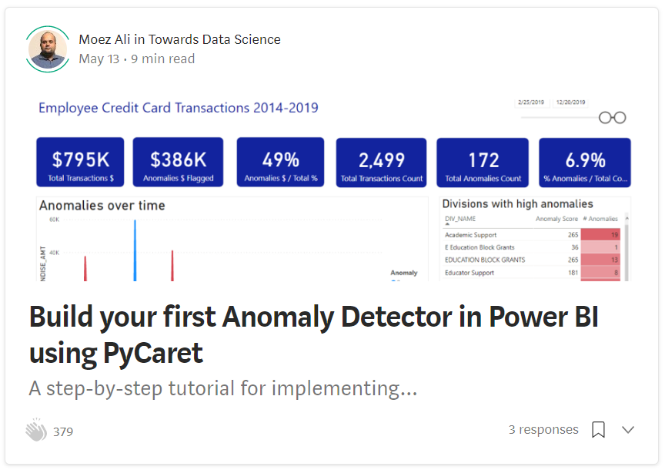
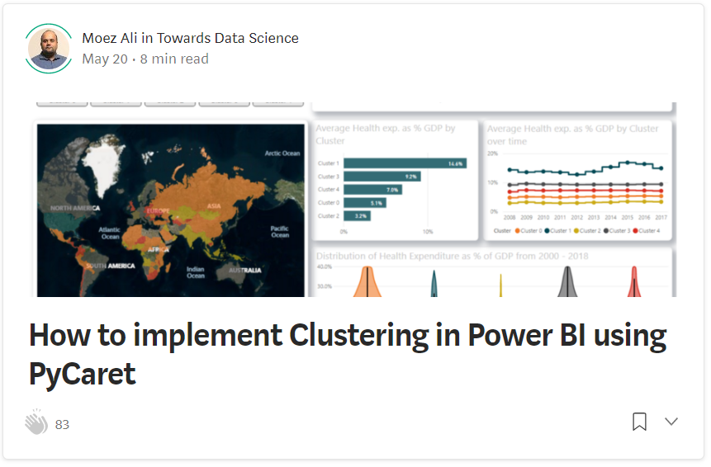
Resources
https://towardsdatascience.com/build-your-first-anomaly-detector-in-power-bi-using-pycaret-2b41b363244e
https://towardsdatascience.com/how-to-implement-clustering-in-power-bi-using-pycaret-4b5e34b1405b

Slide 5
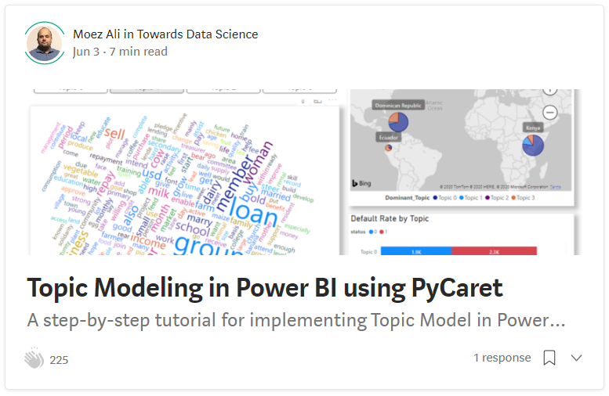
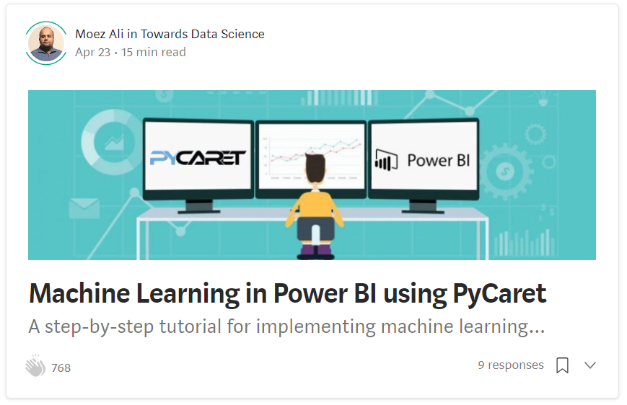
Resources (cont.)
https://towardsdatascience.com/topic-modeling-in-power-bi-using-pycaret-54422b4e36d6
https://towardsdatascience.com/machine-learning-in-power-bi-using-pycaret-34307f09394a

Slide 6
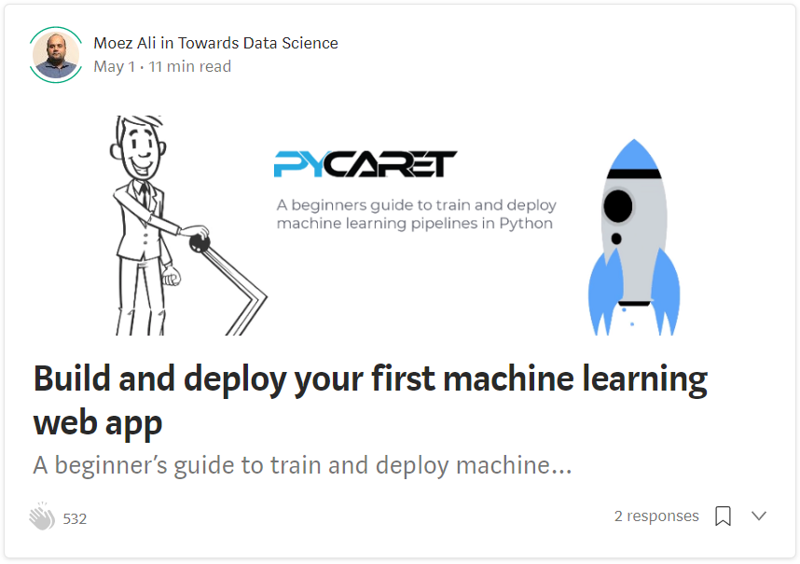
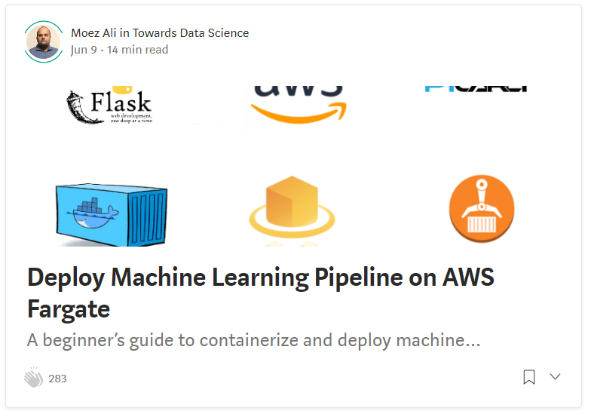
Resources (cont.)
https://towardsdatascience.com/build-and-deploy-your-first-machine-learning-web-app-e020db344a99
https://towardsdatascience.com/deploy-machine-learning-pipeline-on-aws-fargate-eb6e1c50507

Slide 7
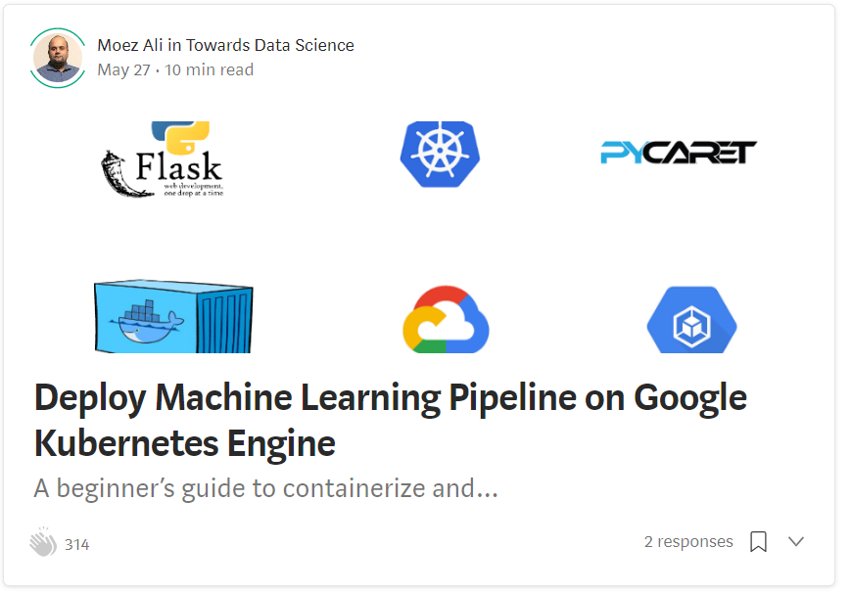
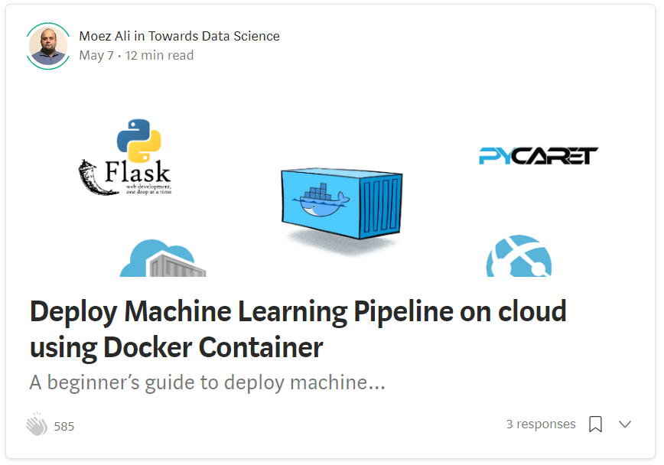
Resources (cont.)
https://towardsdatascience.com/deploy-machine-learning-model-on-google-kubernetes-engine-94daac85108b
https://towardsdatascience.com/deploy-machine-learning-pipeline-on-cloud-using-docker-container-bec64458dc01

Slide 8
Resources (cont.) – Official Video Tutorials
Binary Classification Video Tutorial
https://www.youtube.com/watch?v=2xAgLKUN6Xs
Clustering in PyCaret Video Tutorial
https://www.youtube.com/watch?v=2oxLDir7foQ
Anomaly Detection in PyCaret Video Tutorial
https://www.youtube.com/watch?v=q0dxYDq1A40&t=2s
Topic Modeling in PyCaret Video Tutorial
https://www.youtube.com/watch?v=G6ShuoM3T1M
Association Rule Mining in PyCaret Video Tutorial
https://www.youtube.com/watch?v=XYAGwts5qGw

Slide 9
Resources (cont.)
Machine Learning in SQL by Umar Farooque
https://towardsdatascience.com/machine-learning-in-sql-using-pycaret-87aff377d90c
PyCaret’s integration with Tableau by Andrew Cowan-Nagora
https://towardsdatascience.com/machine-learning-in-tableau-with-pycaret-166ffac9b22e
NLP Classification using PyCaret by Prateek Baghel
https://towardsdatascience.com/predicting-crashes-in-gold-prices-using-machine-learning-5769f548496
Predict Gold Price Returns using PyCaret by Riazuddin Mohammad
https://towardsdatascience.com/machine-learning-to-predict-gold-price-returns-4bdb0506b132
Predict Crashes in Gold Price using PyCaret by Riazuddin Mohammad
https://towardsdatascience.com/predicting-crashes-in-gold-prices-using-machine-learning-5769f548496

Slide 10
Resources (cont.)
Binary Classification Notebook by Murali Tedla
https://colab.research.google.com/drive/1W6ZYw5oAN7V85utFkXkCQq3iBWjqP1WB
Wine Quality Prediction by Abhinav Arora
https://colab.research.google.com/drive/1uFNmhgM9ghVrtqN3MXaofxDlLePb3yIi#scrollTo=sYsHyY8uH6tb
Build your machine learning models by Lakshay Arora
https://www.analyticsvidhya.com/blog/2020/05/pycaret-machine-learning-model-seconds/
PyCaret’s Integration with Power BI (1 Hour Video Tutorial)
https://www.youtube.com/watch?v=ZeQVkEWo2x0
Anomaly Detection using PyCaret by Krish Naik (Video Tutorial)
https://www.youtube.com/watch?v=ZeQVkEWo2x0

Slide 11
What do you need to follow along?
Power BI Desktop
Download https://powerbi.microsoft.com/en-us/downloads/
Anaconda Distribution with Python 3.6 or greater.
Download: https://www.anaconda.com/products/individual
PyCaret
Install https://www.pycaret.org/install

Slide 12
Create Environment and Install PyCaret
Execute following code in Anaconda Terminal:
conda create --name powerbi python=3.7
conda activate powerbi
pip install pycaret
python -m ipykernel install --user --name powerbi --display-name "powerbi"
https://www.pycaret.org/install

Slide 13
Let’s get started

Slide 14
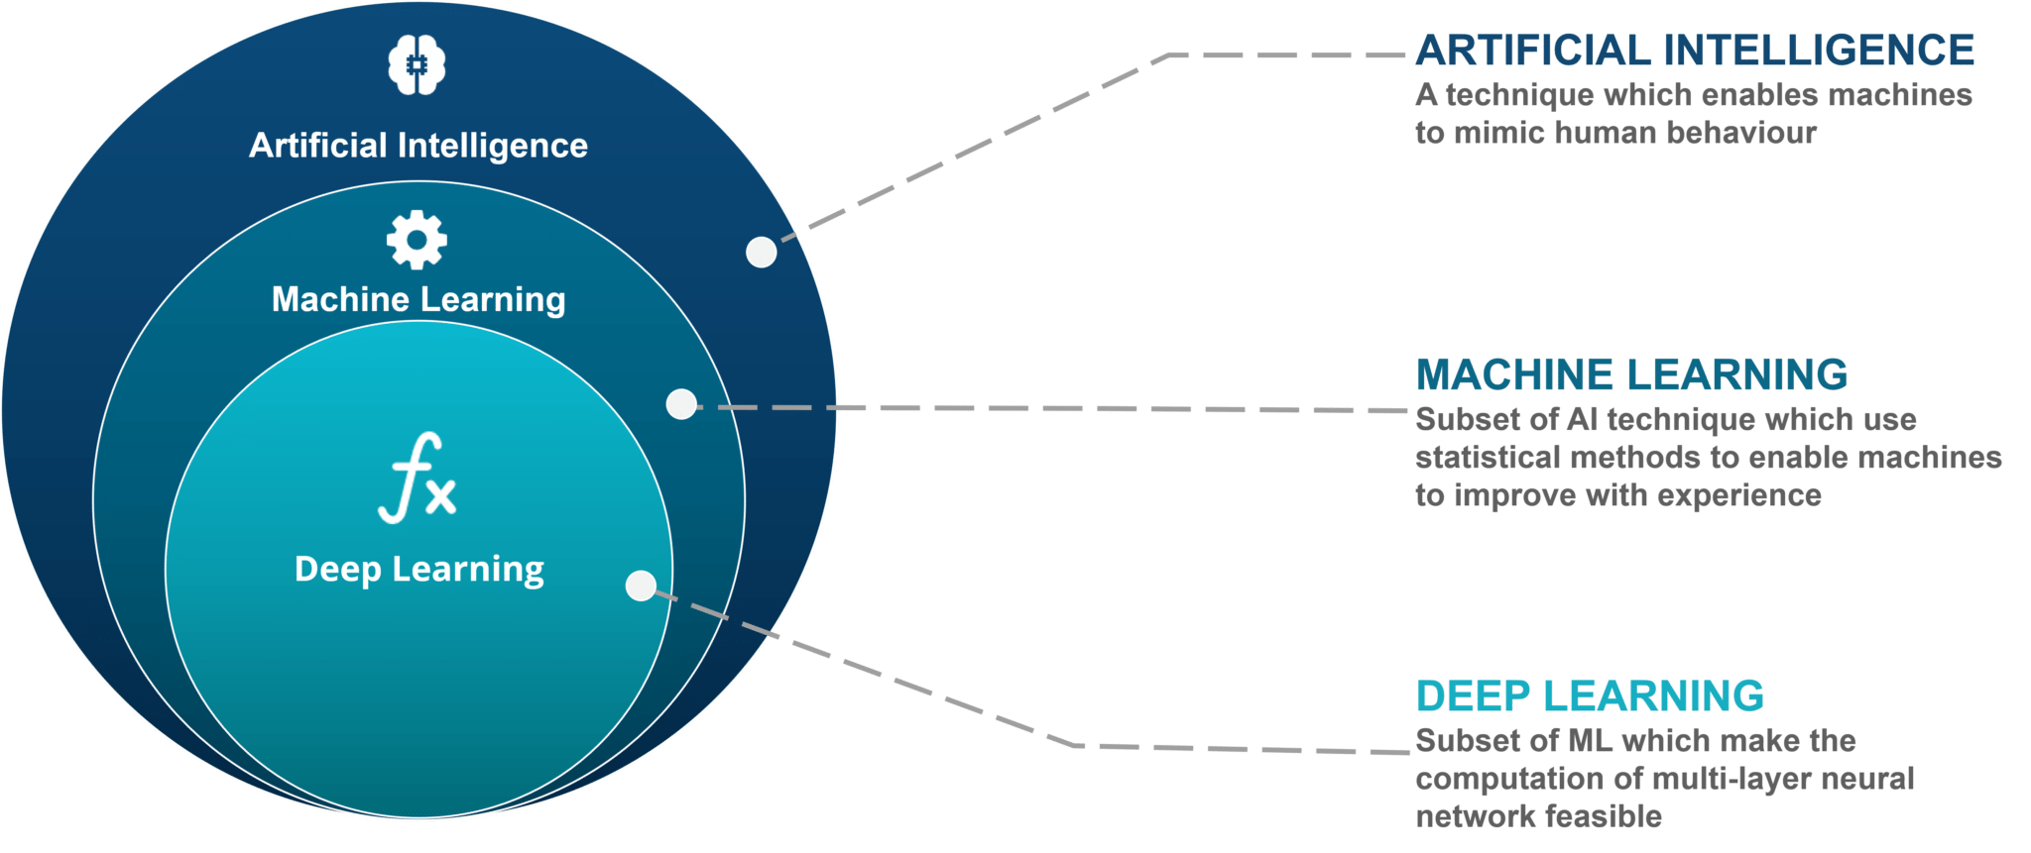

Slide 15
What is Machine Learning?
Machine Learning is an application of artificial intelligence (AI) that provides systems the ability to automatically learn and improve experience without being explicitly programmed.
The goal of machine learning is to predict outcomes based on historical data

Slide 16
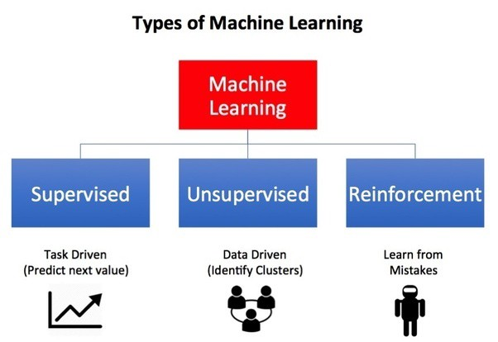

Slide 17
Types of Predictions
To predict continuous values such as Sales $, Revenue $, Consumption, Temperature, Regression is used.
To predict discrete outcome such as customer will leave or stay, opportunity will materialize or not, disease found or not, buy or not etc., Classification is used.

Slide 18
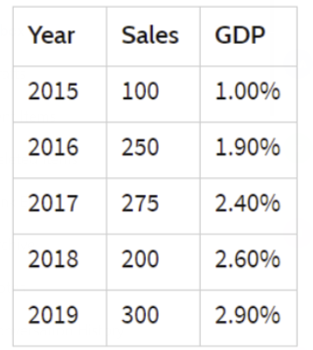
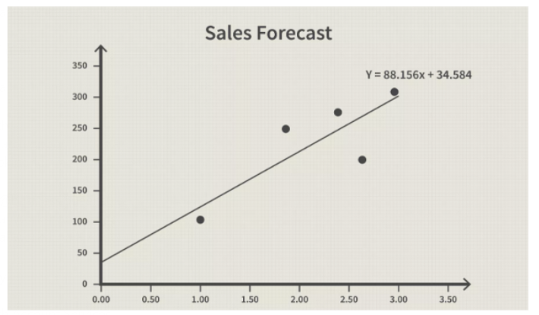
Example 1
Company ABC wants to predict Sales for next year given the historical information on GDP and Sales

Slide 19
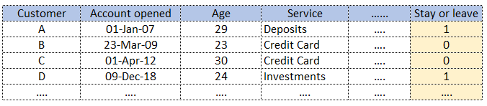
Example 2
A bank wants to predict whether the customer will stay or leave next month?

Slide 20
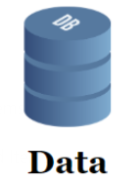

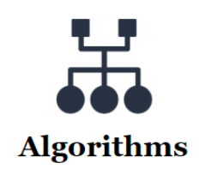
Components of Machine Learning
Structured
Rows x Columns
Unstructured
Images, Video, Audio, Text
Also known as:
Variables
Attributes
Independent Variables
Some common algorithms:
Linear Regression
Decision tree
Random Forest
Etc. etc.

Slide 21



What is PyCaret?
PyCaret is an open source, low-code machine learning library in Python that aims to reduce the cycle time from hypothesis to insights. PyCaret can be used for rapidly developing and deploying machine learning pipeline.
EASY TO USE
PRODUCTIVITY TOOL
BUSINESS READY

Slide 22
Demo

Slide 23
Thank you – Questions?

